Slide 1
PROJECT TITLE
PIP104 PROFESSIONAL PRACTICE-II
VIVA-VOCE
Batch Number: CSE-G111
Under the Supervision of,
Ms. RAKHEEBA TASEEN
Assistant Professor
School of Computer Science & Engineering
Presidency University Bangalore
ROLL NO. | NAME
20201CSE0634 | Aniket Choudhary
20201CSE0640 | Akif Saeed
20201CSE0641 | Tharik Ahamed

Slide 2
Introduction
My City Information simplifies city life in bustling Indian metropolises, offering a comprehensive mobile app.
The app serves as a unified platform, compiling information across diverse categories for an enriched urban experience.
Explore the city's charm, discover accommodations, and access healthcare insights effortlessly.
Bridge information gaps with emergency lifelines, an educational compass, and community connections.
Beyond the ordinary, prioritize every generation's care, stay on time with real-time schedules, and ensure safety with geolocation technology.
My City Information transforms into a transformative tool, empowering users to navigate urban life with confidence and connection.

Slide 3
Literature Review
Existing Mobile Apps:
m-Indicator India: Government-developed app with socio-economic data; complex interface
Incredible India: Official tourism app; limited to tourism information
Namma Bengaluru: City-specific app for Bengaluru residents; lacks broader applicability

Slide 4
 | Research Contribution
Mobile Governance Applications in India: A Critical Analysis | This study underscores the potential of mobile apps in enhancing citizen engagement and government transparency in India. It emphasizes the necessity for user-friendly interfaces, localized content, and data accuracy to foster wider adoption. | By Sharma et al. (2017)
Leveraging Mobile Technology for Public Service Delivery in Indian Cities | Exploring the use of mobile apps for delivering essential services in Indian cities, this research identifies challenges related to digital literacy and infrastructure gaps that need addressing. | By Kumar and Singh (2019)
Designing Mobile Apps for Urban Governance in Developing Countries | This paper stresses the importance of context-specific design and community engagement in developing effective mobile apps for urban governance in developing countries. | By Agarwal and Sen (2020)

Slide 5
Research Gaps Identified
Key Gaps:
Limited scope
Data accuracy
Accessibility
Personalization
Integration with public services
Offline accessibility
Social interaction
Addressing the digital divide.
Opportunities:
My City Information aims to bridge these gaps and offer a comprehensive solution.

Slide 6
Proposed Methodology
Phases:
Requirements gathering
design and development
testing and deployment
maintenance and iteration.
Approach:
Agile methodology, user-centric design, and continuous improvement.

Slide 7
Objectives
Overall Objective:
Empower Indian citizens with easily accessible and comprehensive public information.
Specific Objectives:
Information accessibility
User-centric design
Data accuracy
Personalization
Bridging the digital divide
Continuous improvement

Slide 8
System Design & Implementation
Modules:
UI/UX
data management
backend services.
Implementation Stages:
MVP
Phased development
Agile methodology.
Challenges:
Data accuracy
Offline access
Map Inaccuracy

Slide 9
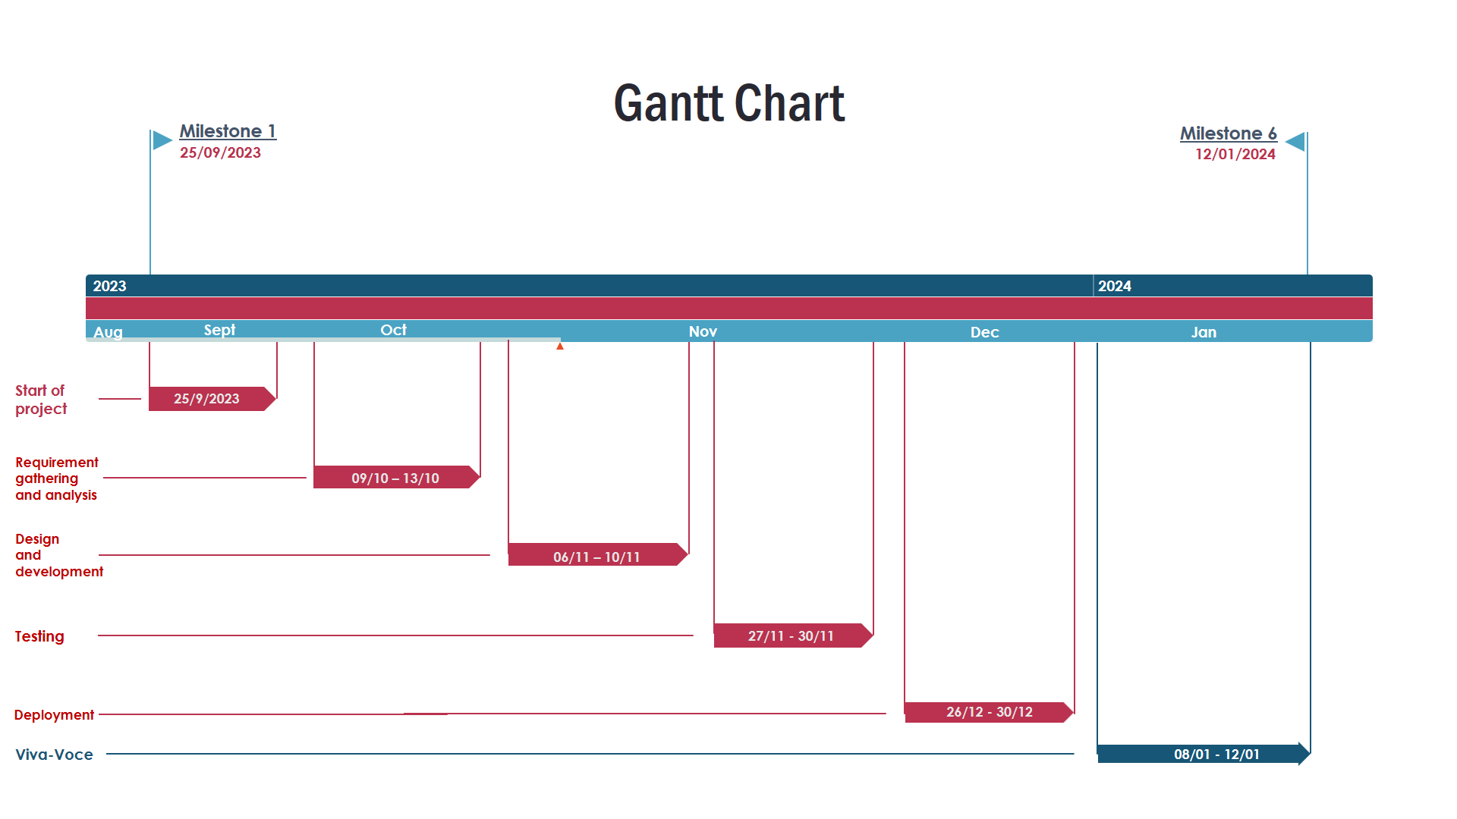
Timeline of Project

Slide 10
Outcomes / Results Obtained
Achievements:
Interactive navigation
Real-time updates.
Limitations:
Educational center information
Comprehensive public place listing.
Future Development:
Continuous improvement and expansion.

Slide 11
Conclusion
Recapitulating the impact and outcomes of My City Information.
Future Vision:
Integration with public services
Nearby locations for utilities
AI support
Expansion to other cities
Community partnerships.

Slide 12
References
Sharma et al. (2017): Search for the title "Mobile Governance Applications in India: A Critical Analysis" in academic databases or online journals.
Kumar and Singh (2019): Look for "Leveraging Mobile Technology for Public Service Delivery in Indian Cities" in academic databases.
Agarwal and Sen (2020): Search for "Designing Mobile Apps for Urban Governance in Developing Countries" in academic databases.
News API: https://newsapi.org/docs
OpenWeather API: https://openweathermap.org/current
Flutter Map SDK: https://docs.fleaflet.dev/

Slide 13
Publication Details

Slide 14

Thank You

